Slide 1
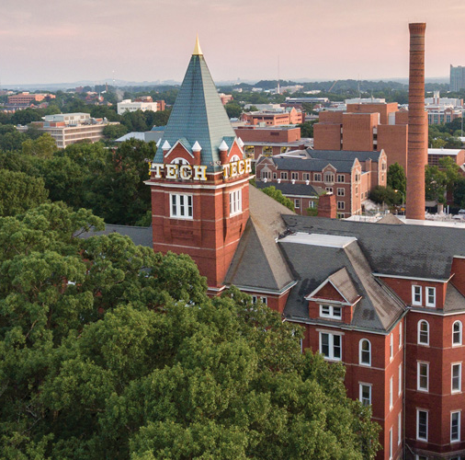

Heredity
Division B
Georgia Tech Event Workshop Series 2025-26

Slide 2
Where to start (general)
Rules manual (for all events!) (make sure you’re looking at the correct division)
Look in detail → Regional vs State vs National
What to bring (make a list with partner)
Binder or papers?

Slide 3
Heredity: Event Overview
Class 2 calculator (check on scioly website about what this means)
Writing utensils (pencils, pen, eraser) (bring extra!)
“Each team may bring one (1) 8.5” x 11” sheet of paper that may contain information on both sides in any form and from any source. The sheet of paper may be laminated or placed in a sheet protector to increase durability. Affixed labels, as well as multiple sheets of paper (whether in a single sheet protector or not) are prohibited.” (will refer to this as “cheat sheet” in workshop)
50 minutes to take the test
Do practice tests using this time limit to get an idea

Slide 4
Calculator Info
https://scioly.org/wiki/Calculators

Slide 5
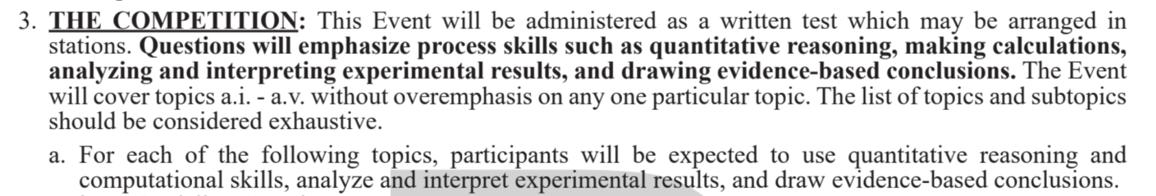
Test

Slide 6
Mendelian Genetics
(1) Describe Mendel’s Laws of Inheritance and their implications in heredity. State and Nationals
only: Describe inheritance patterns which violate these laws (i.e. linkage, incomplete and
codominance, complementation).
(2) Use provided information to construct Punnett Squares of mono- and dihybrid crosses.
(3) Predict genotypes and phenotypes of offspring and compute their likelihood based on Punnett Squares and experimental data using probability rules.
(4) Evaluate pedigrees to predict modes of inheritance (i.e. dominant vs recessive traits and
autosomal vs sex-linked traits) and construct pedigrees based on data from a case study. (5) State and Nationals Only: Understand recessive epistasis and its implications in predicting
phenotypic outcomes.

Slide 7
2. Mitosis and Meiosis
(1) Understand, compare, and contrast the major stages and key structures in mitosis and meiosis
(2) Understand the steps involved in human karyotype analysis and be able to interpret a karyotype

Slide 8
3. Molecular Biology of DNA
(1) Be able to identify and explain the components of DNA (i.e. structure of the nucleotides and
backbone), directionality of DNA (5’ and 3’ ends).
(2) Explain Chargaff’s rules in the context of DNA structure and base pairing.
(3) Understand the basic stages of DNA replication, with focus on DNA elongation and the
processes that happen at the replication fork.
(4) Identify and understand the organization of DNA structure, such as plasmids, chromatin
complexes, euchromatin and heterochromatin, and chromosomes.
(5) State and Nationals only: Identify, explain, and classify DNA mutations on the DNA level (i.e.
chromosomal rearrangements, insertions, deletions, and substitutions), and the potential impact
of the resulting protein sequence (i.e. frameshift, silent, missense, and nonsense mutations).

Slide 9
4. Gene and Protein Relationship
(1) Be able to explain the Central Dogma of Molecular Biology.
(2) Transcription: Understand and explain initiation, elongation, and termination stages of transcription, the mechanism of RNA polymerase, and how transcription is regulated by activators and repressors.
(3) Translation: Understand and explain the initiation, elongation and termination stages of translation, the mechanism of the ribosome, and the role mRNA and tRNA play in translation.
(4) State and Nationals only: Understand the function and mechanism of the lac operon.

Slide 10
5. Technology and Techniques
(1) Polymerase chain reaction (PCR): Describe what occurs and which molecules are involved in the denaturation, annealing, and extension steps of a PCR reaction; Explain the role of temperature in PCR; Identify the components needed for a PCR reaction; Identify experimental questions which could be addressed by PCR.
(2) State and Nationals only: Sanger sequencing: Describe how the steps and components in Sanger sequencing differ from a standard PCR reaction; Identify experimental questions which could be addressed by Sanger sequencing.

Slide 11
How to Start
Look over rules
Split the topics between partners (or all partners do all topics- up to you and how much time you have before the competition)
Go through the wiki to get a rough idea
For each topic, do research and take notes (add important stuff to your “cheat sheet”- 8.5 x 11 paper)
Notes are important to have so you can review them before the competition
Do practice questions about each topic along the way
Khan Academy or ask ChatGPT (more about AI to come in this workshop)
Once you feel you’ve covered the material, do practice tests
Take note of topics you frequently miss. Add important things to your “cheat sheet”

Slide 12
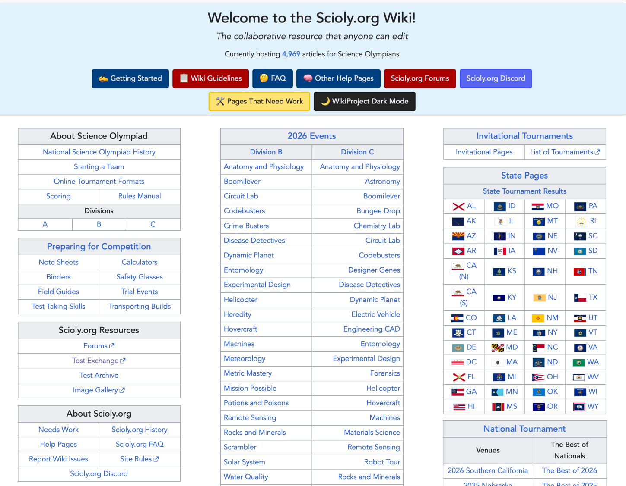
Scioly Wiki
https://scioly.org/wiki/Main_Page

Slide 13
Practice Tests
https://scioly.org/tests/
Ctrl F (and search Heredity) and you’ll find practice tests and keys
Sit down with a timer (50 minutes) and get to work. Go somewhere with no distractions or noise and no devices (other than your timer) and take the test. Then grade your test and see what you missed. You can make note of things you missed (see if there are frequently missed topics) and learn about why you missed the question and what to do or learn differently for next time.

Slide 14
More Practice
You can find Quizlets with Heredity info and practice questions
You can also find videos on YouTube about the event that have practice questions
Also looking up “Heredity Division B Science Olympiad Tests” on Google could bring up more practice tests.

Slide 15
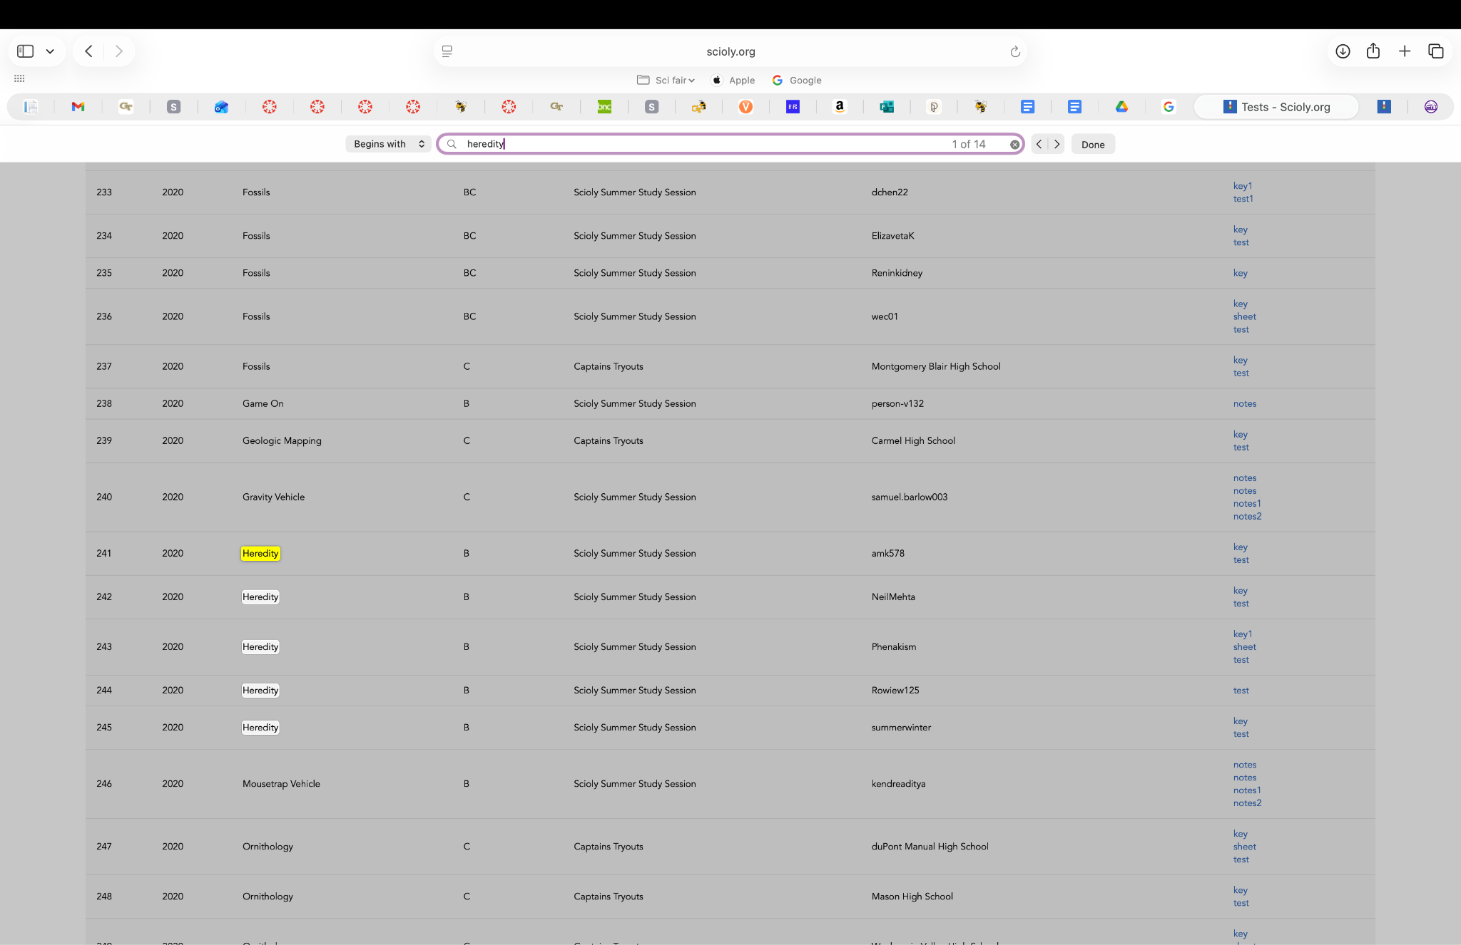

Slide 16
Using AI
Use it as a study resource!
If you have tried to learn a topic various times (through websites and videos) and still don’t get it, ask AI for help. Tell it what the rules manual says that you need to know about the topic or give it a question you’re stumped on. Ask it to explain from the basics!
Use AI ethically as a study tool, and it can help you immensely! Ask it to make practice questions, to go over topics, to give you examples, etc. And always ask it for explanations to make sure you fully understand the content.

Slide 17
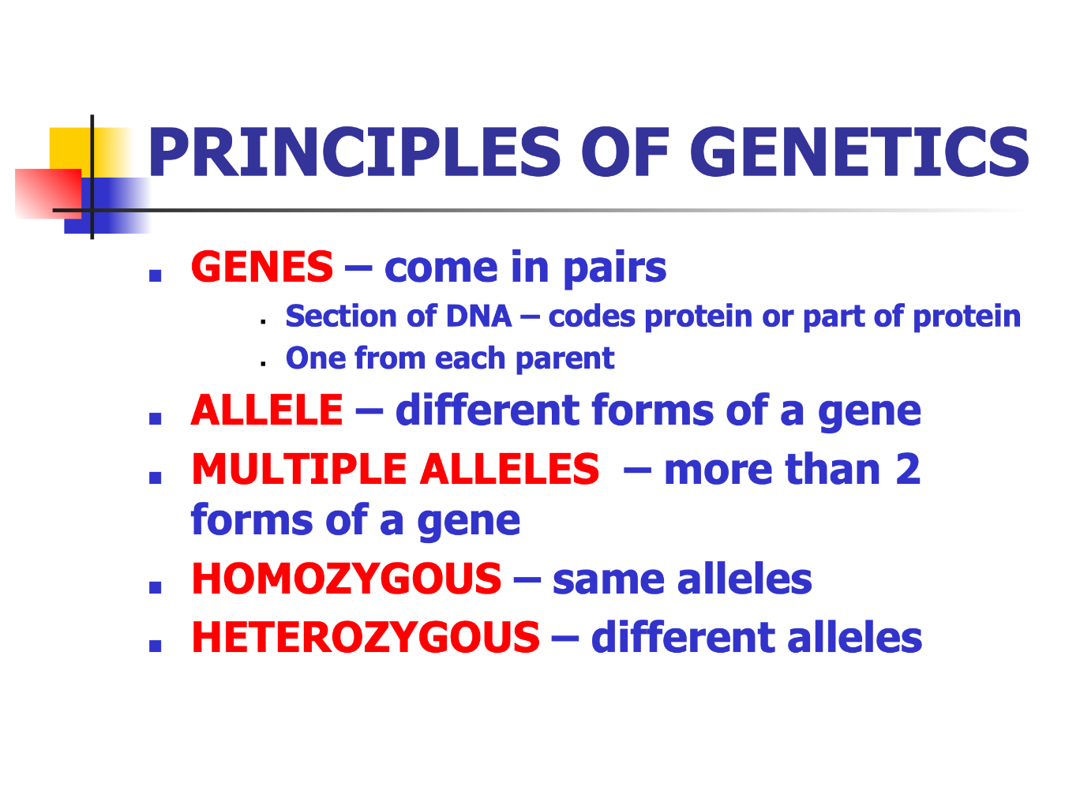

Slide 18
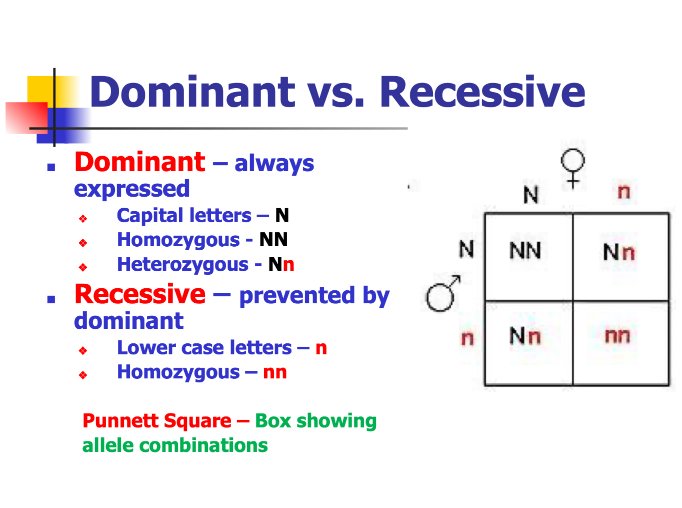

Slide 19
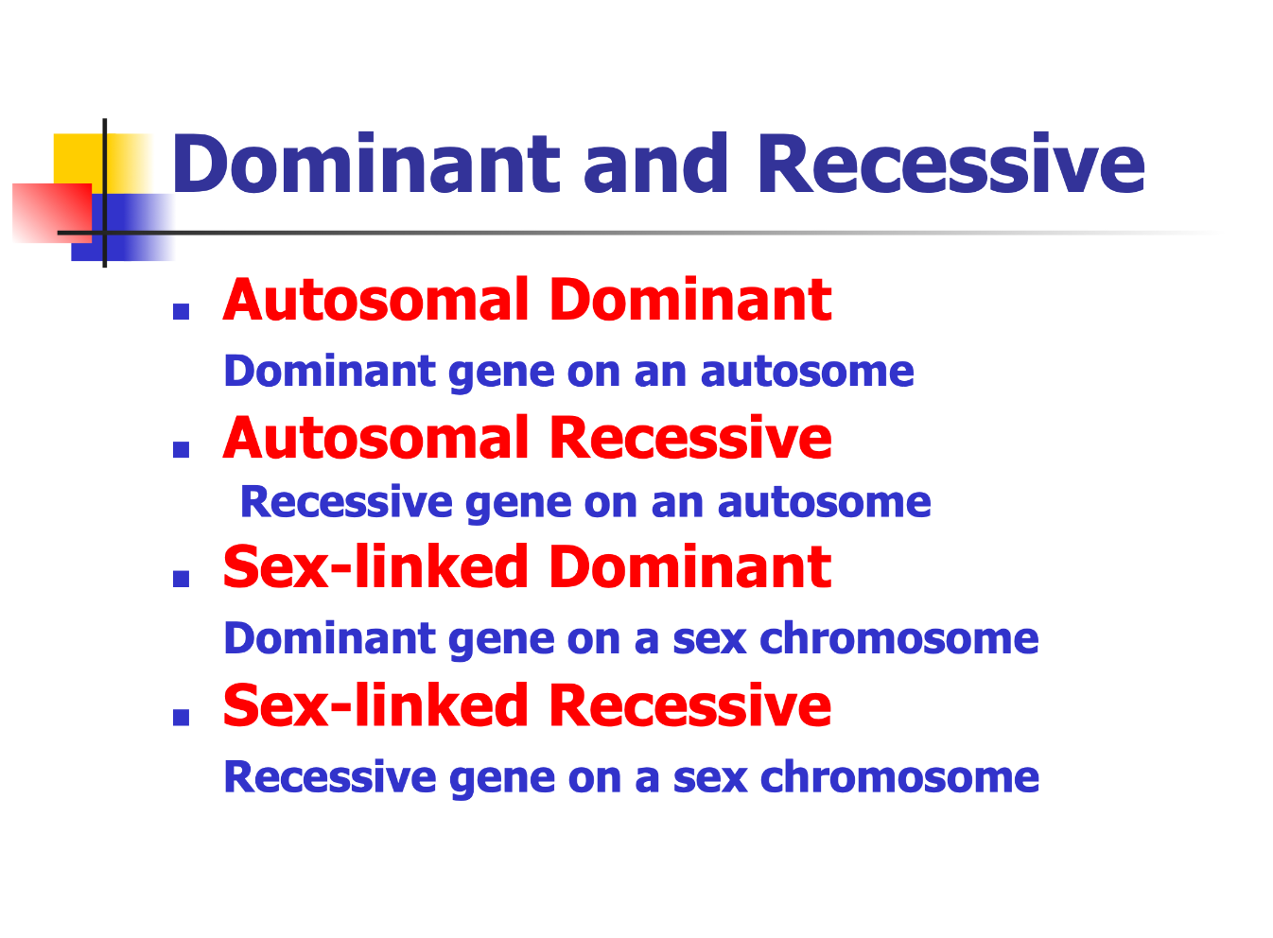

Slide 20
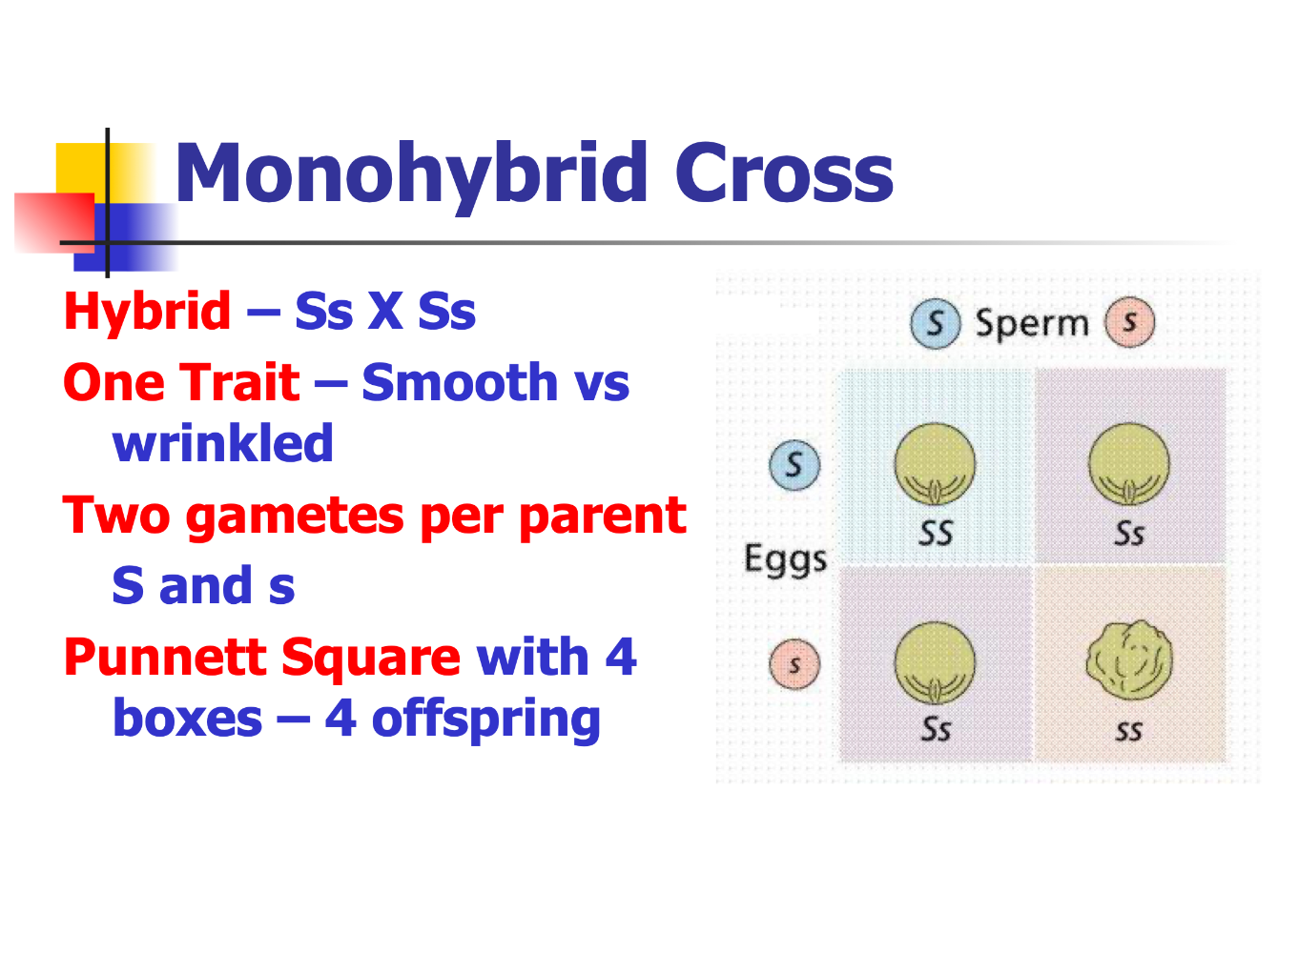

Slide 21
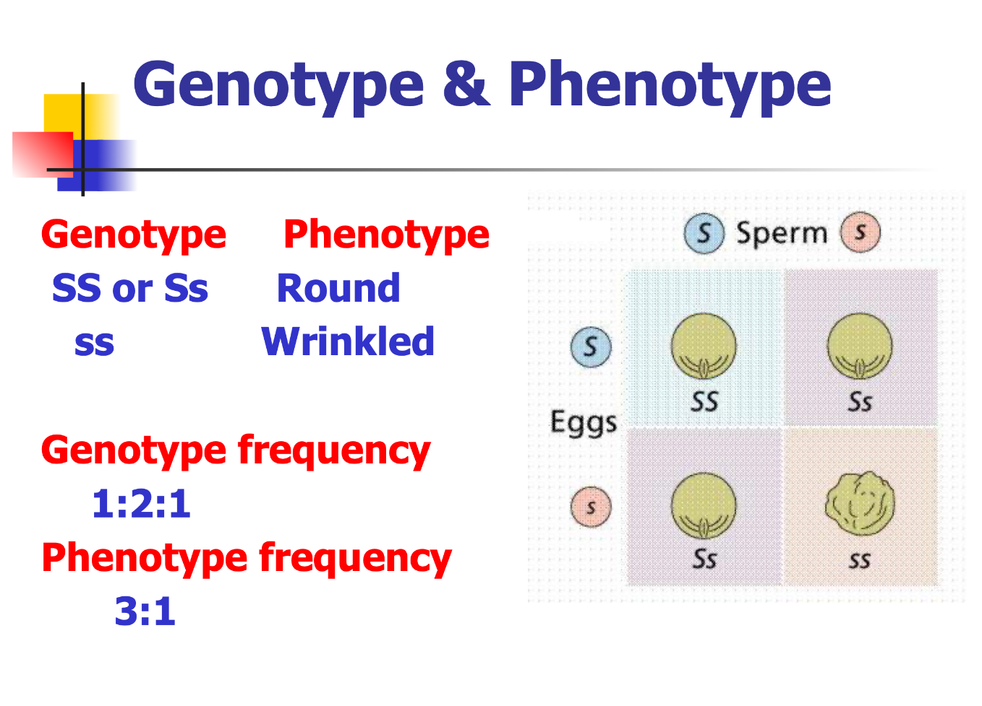

Slide 22
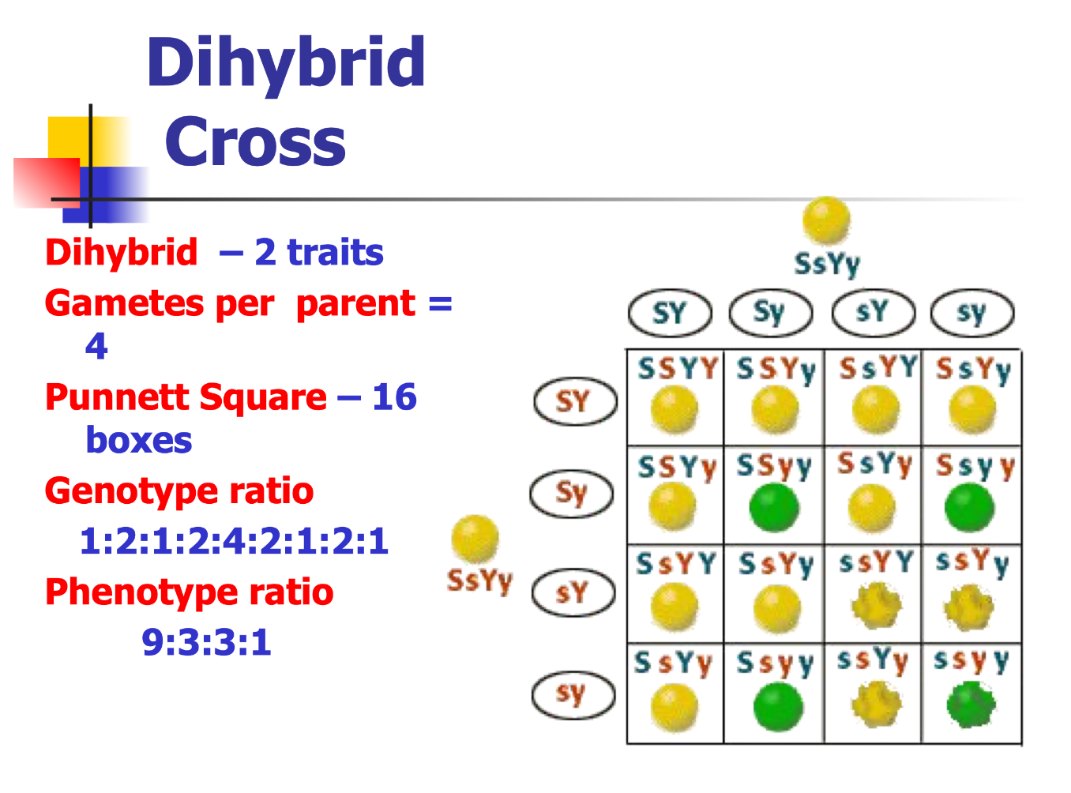

Slide 23
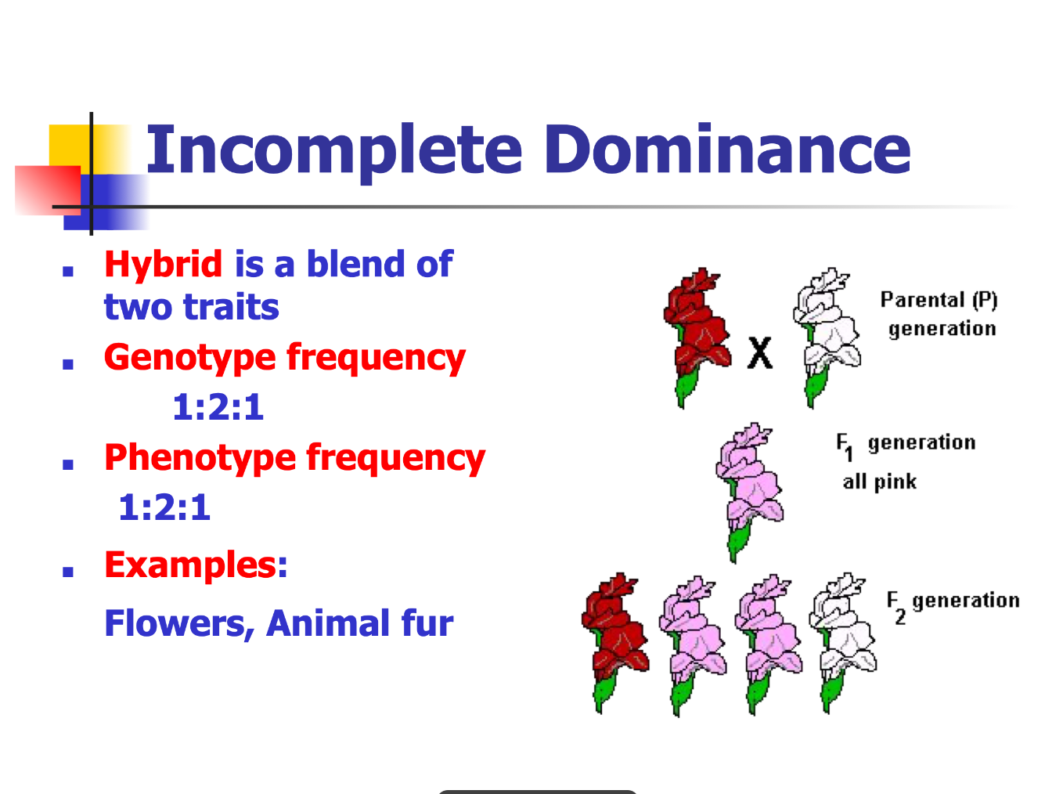

Slide 24
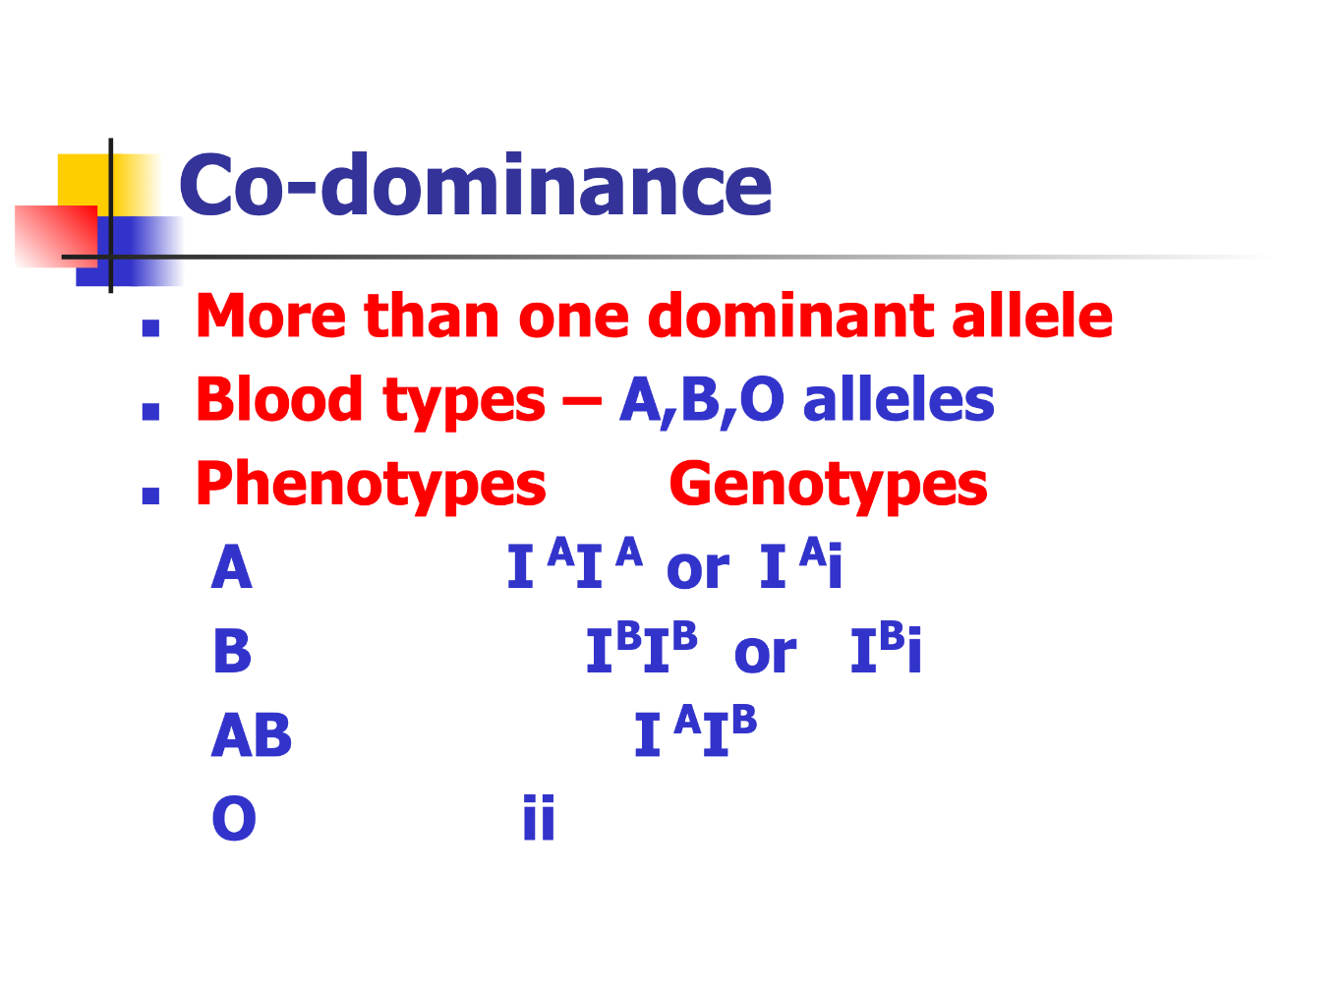

Slide 25
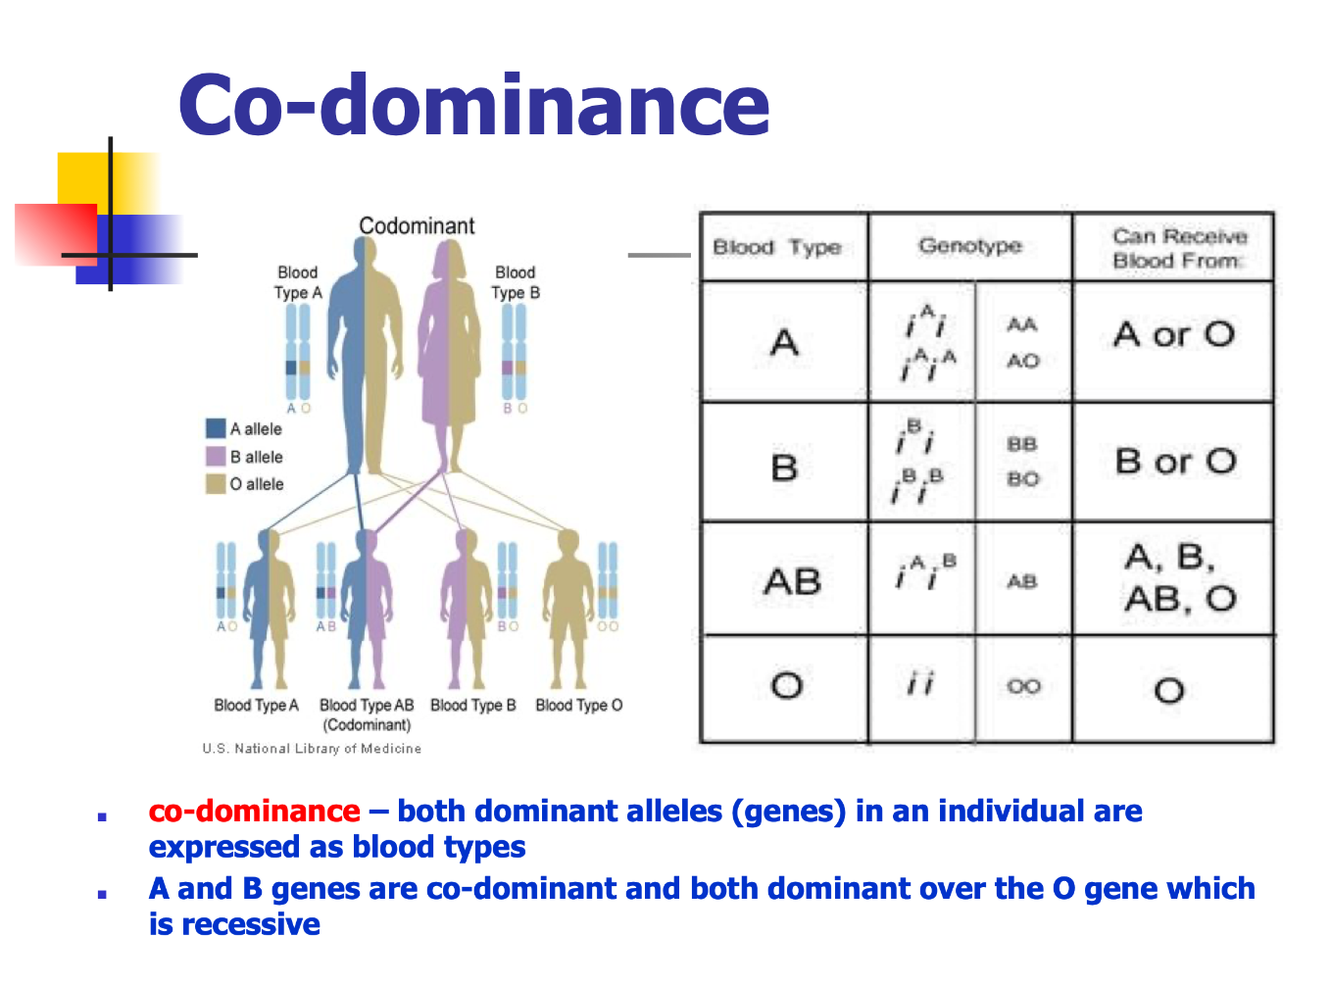

Slide 26
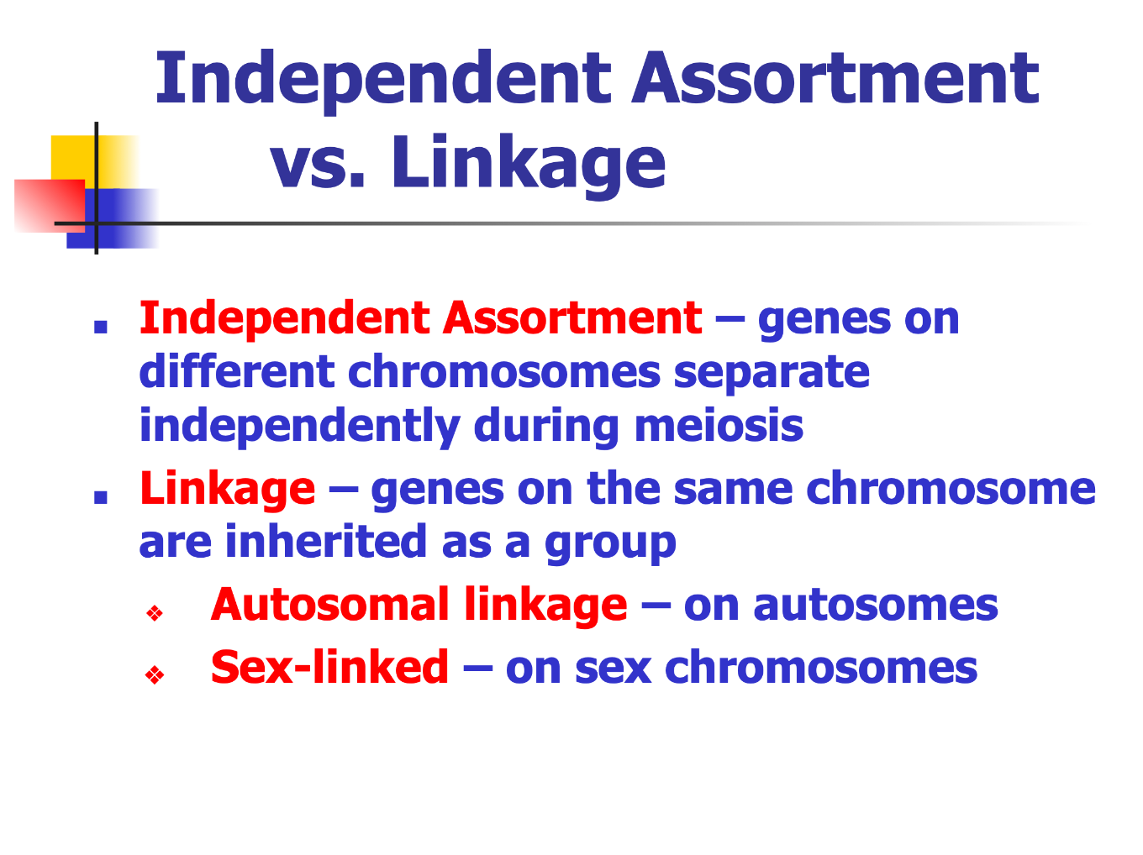

Slide 27
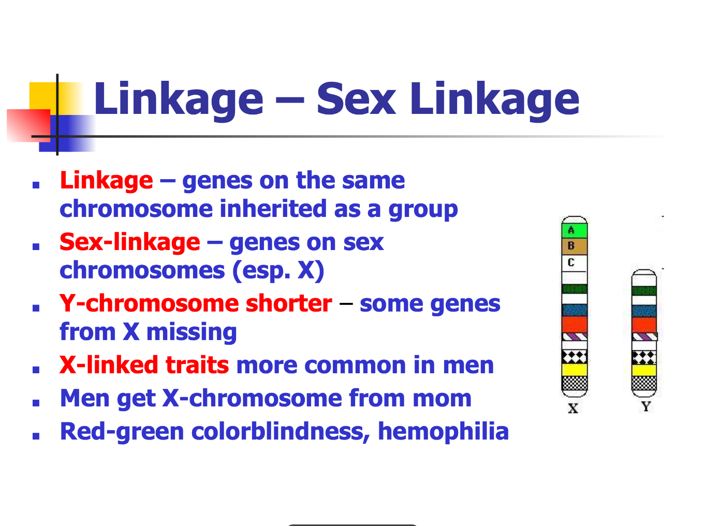

Slide 28
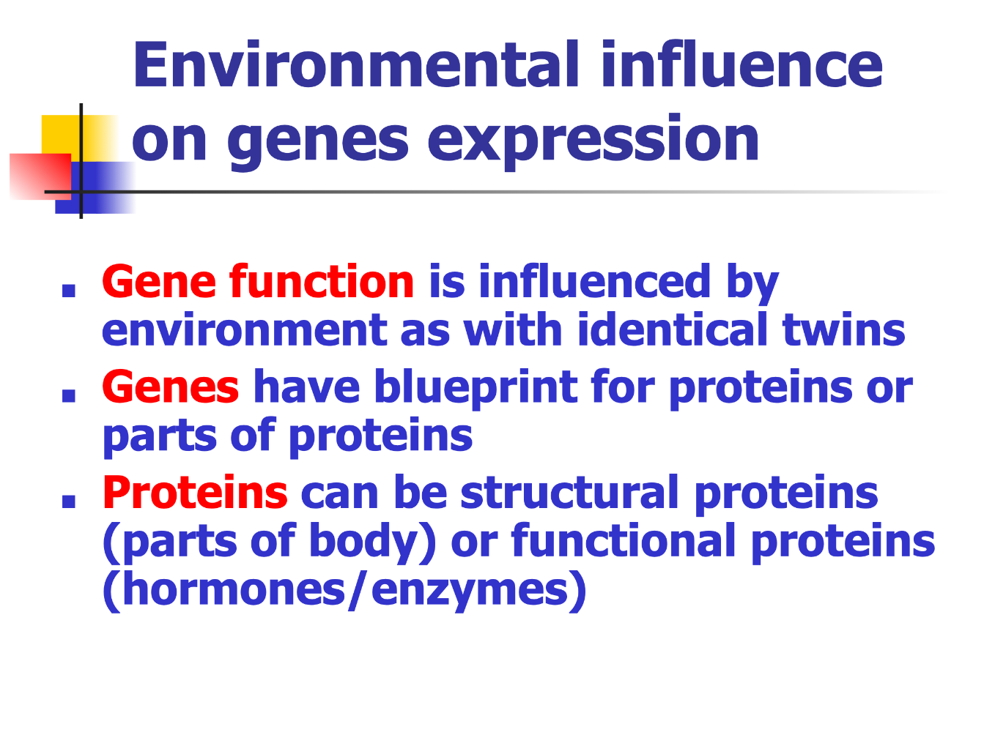

Slide 29
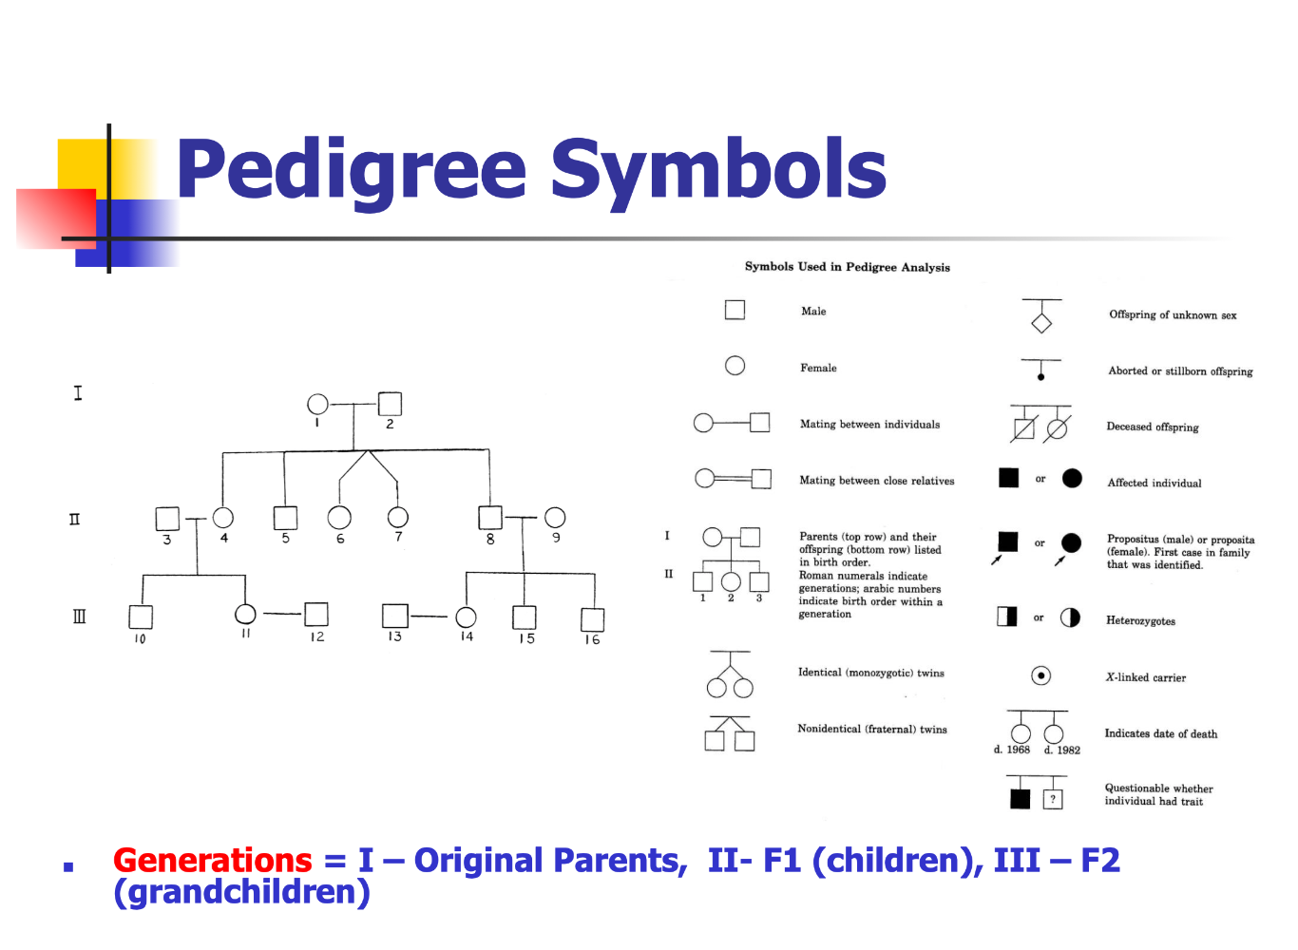

Slide 30
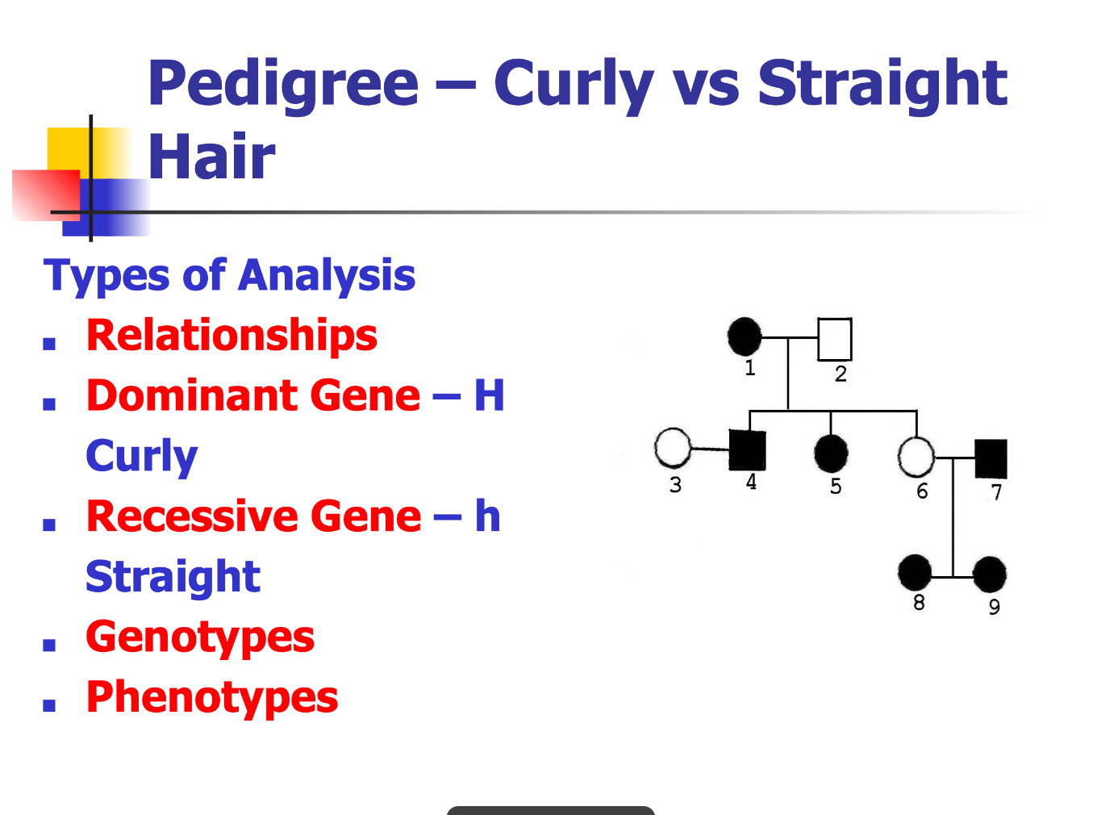

Slide 31
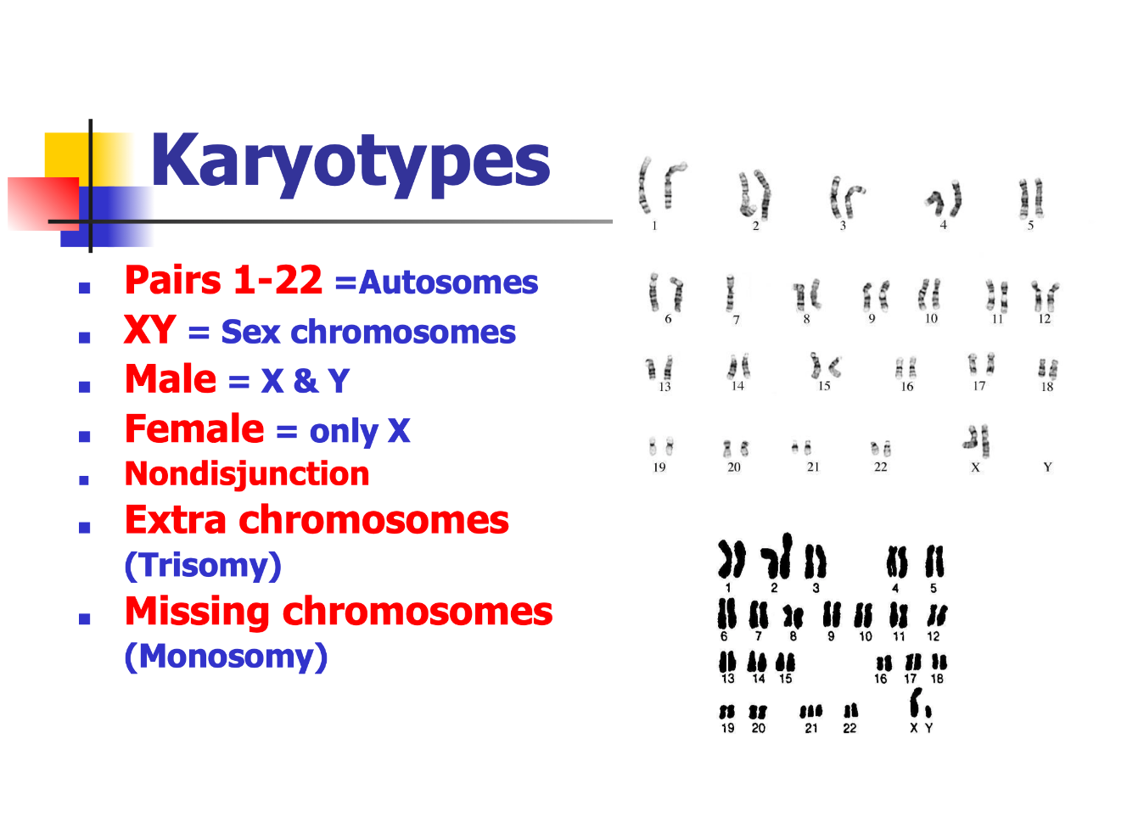

Slide 32
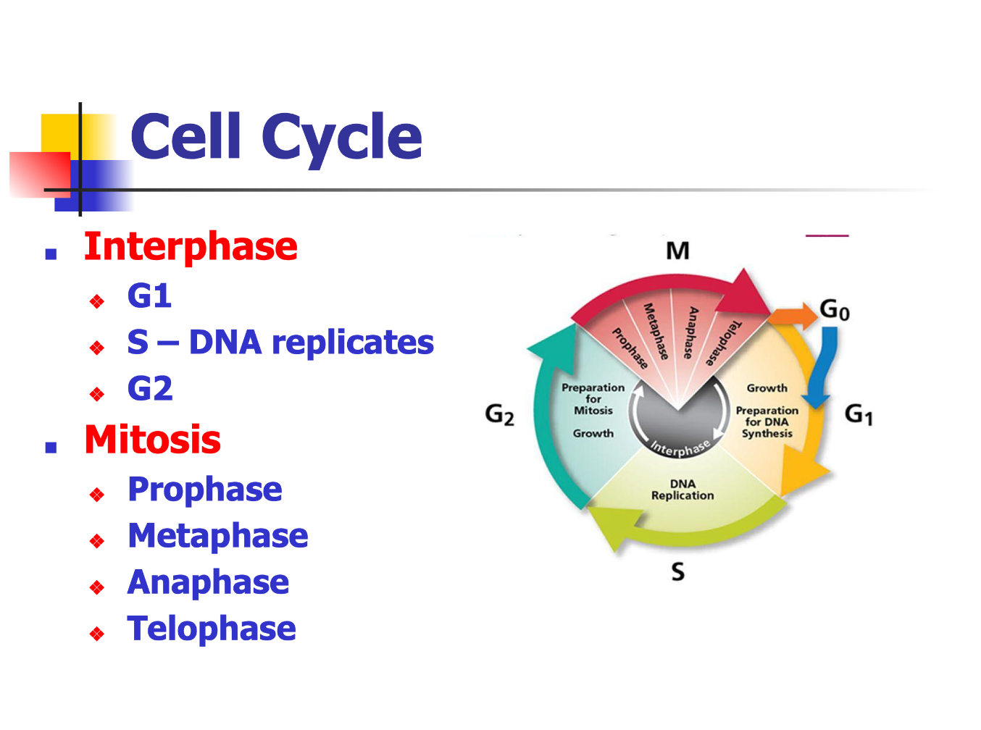

Slide 33
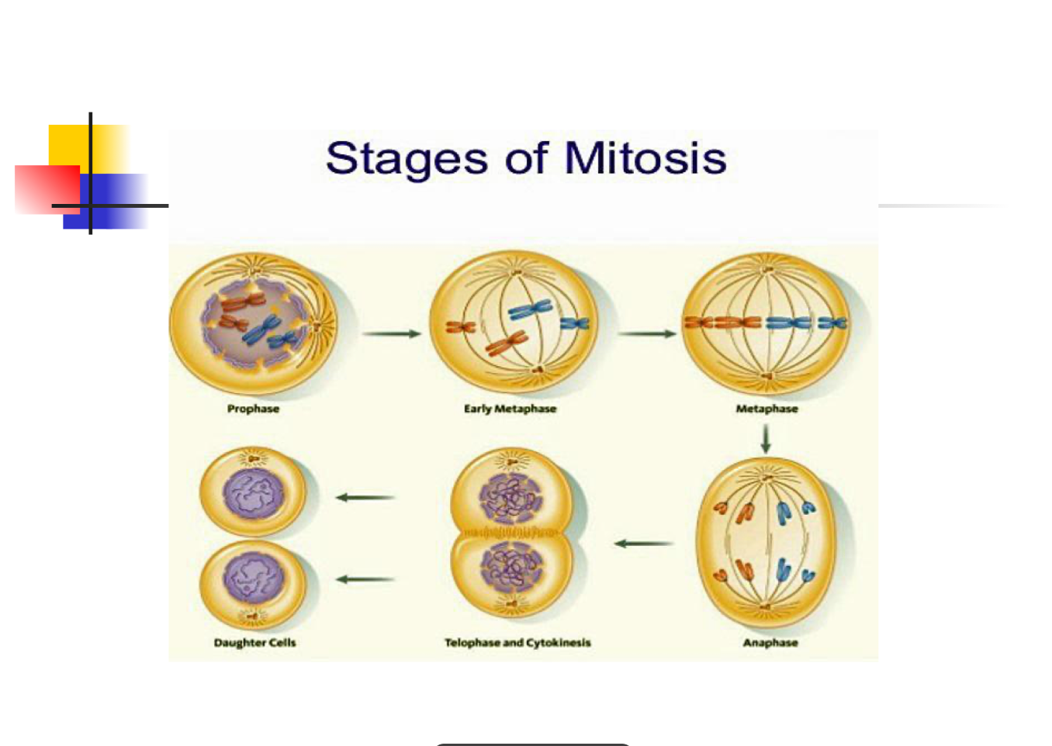

Slide 34
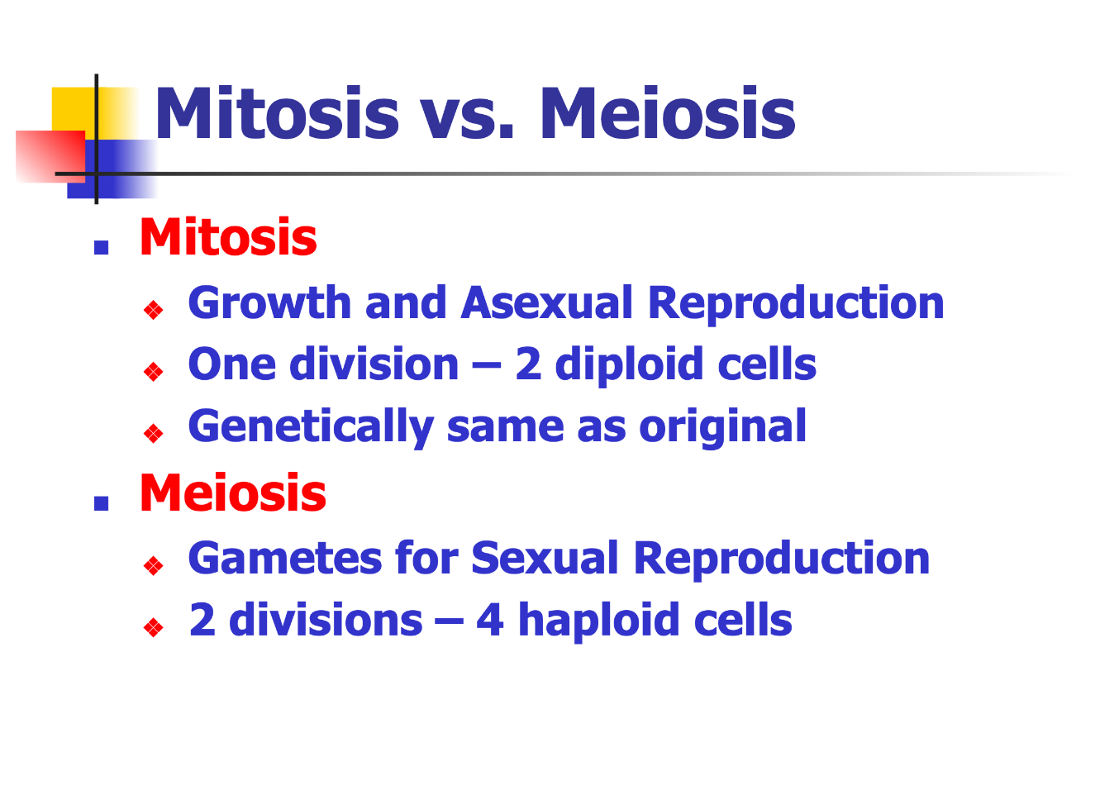

Slide 35
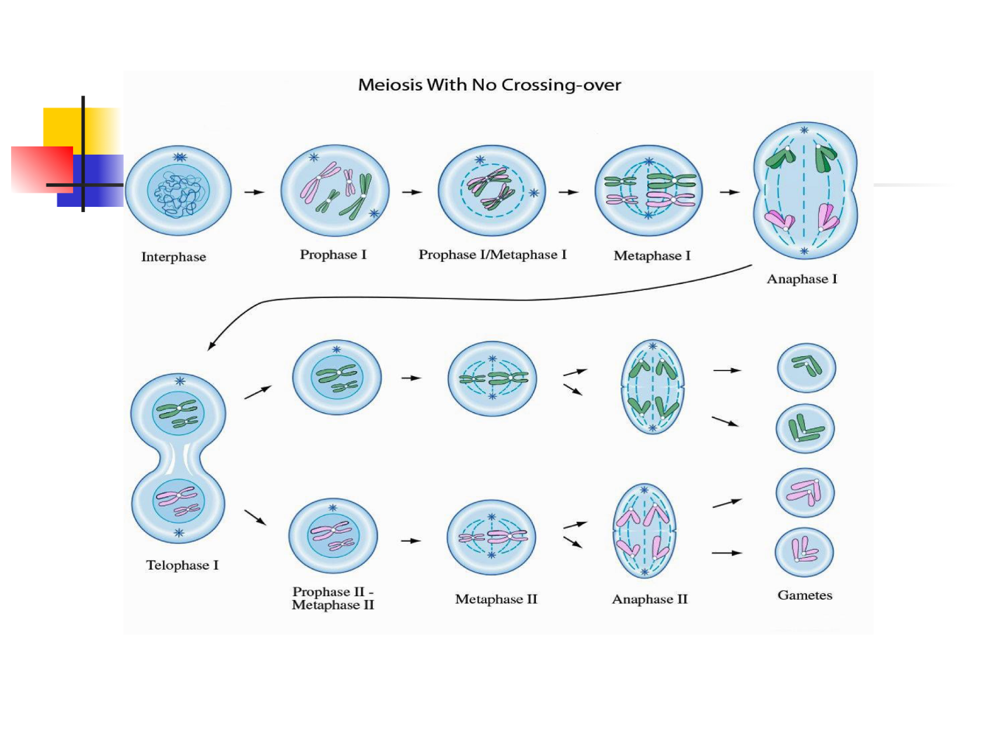

Slide 36
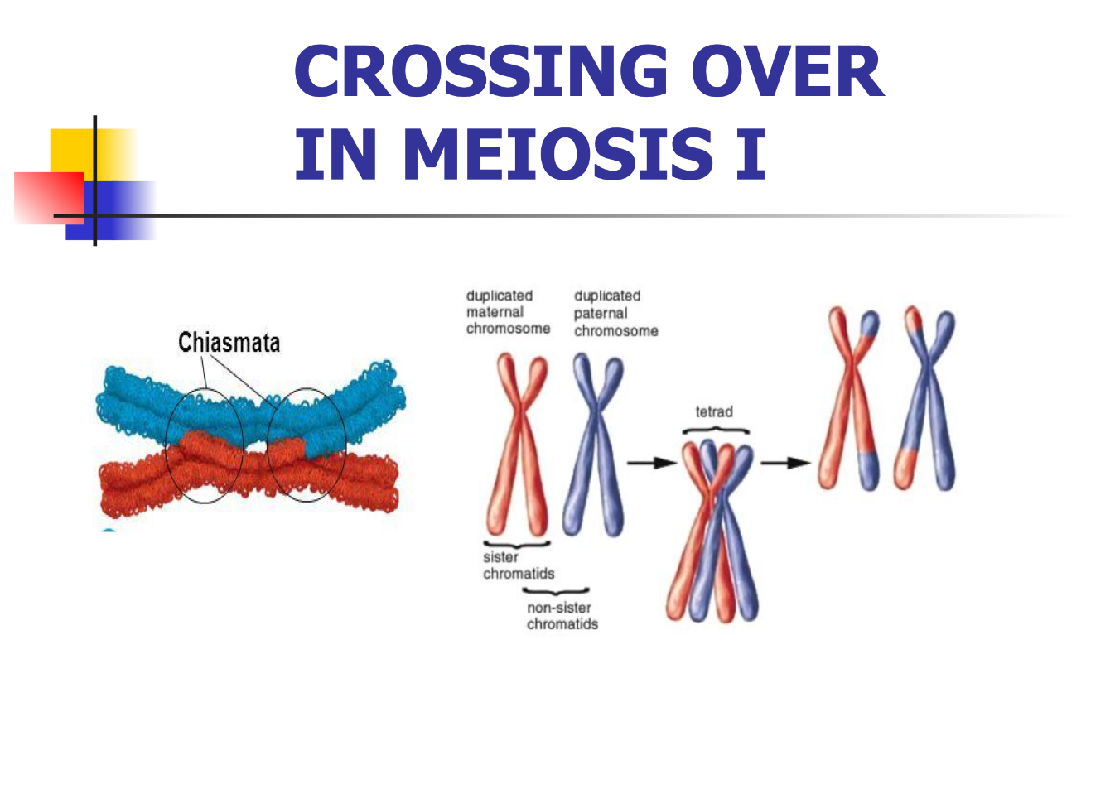

Slide 37
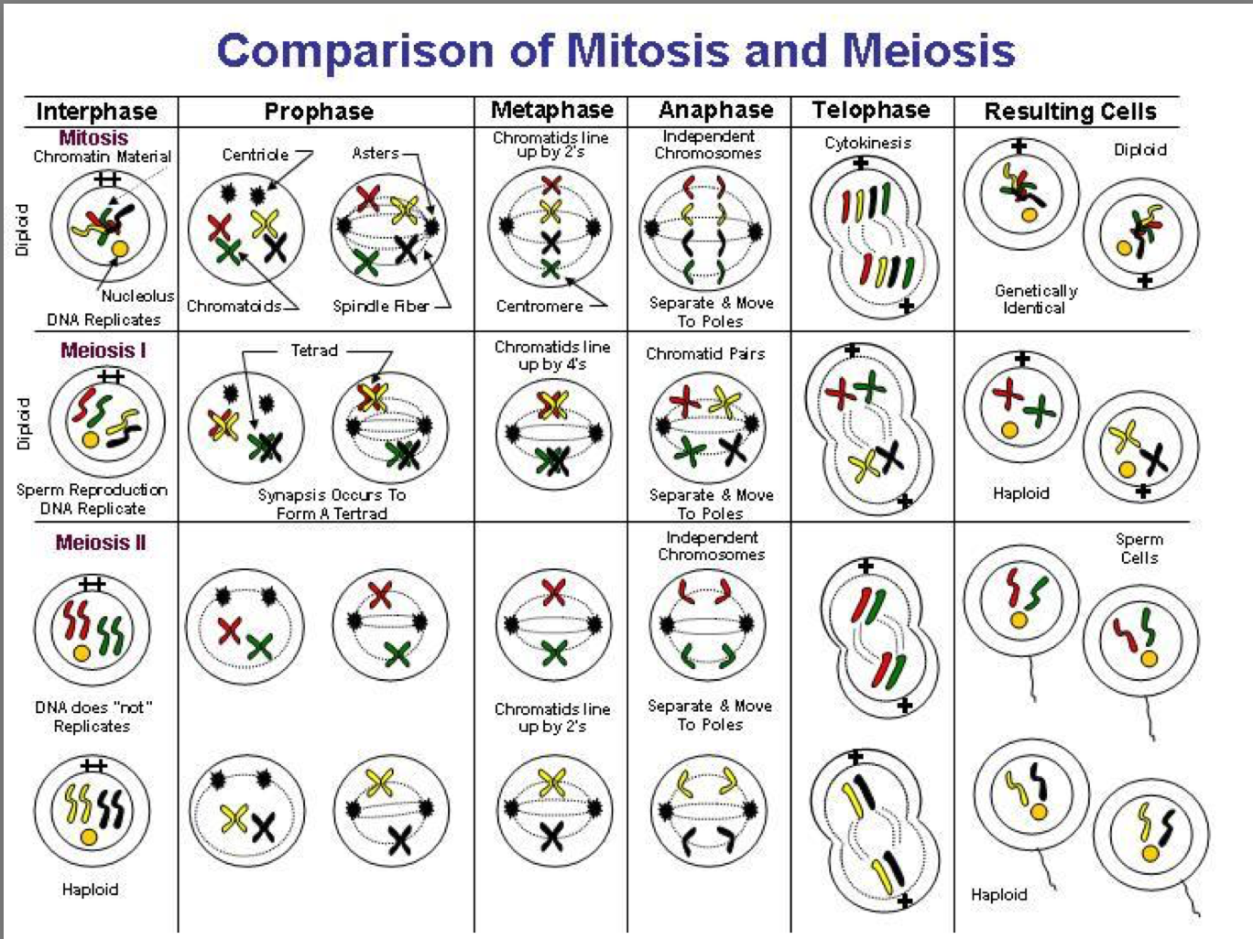

Slide 38
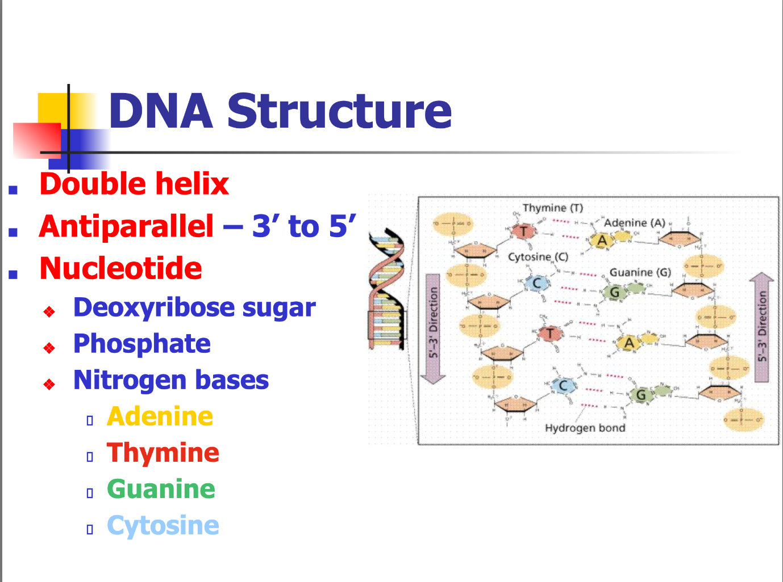

Slide 39
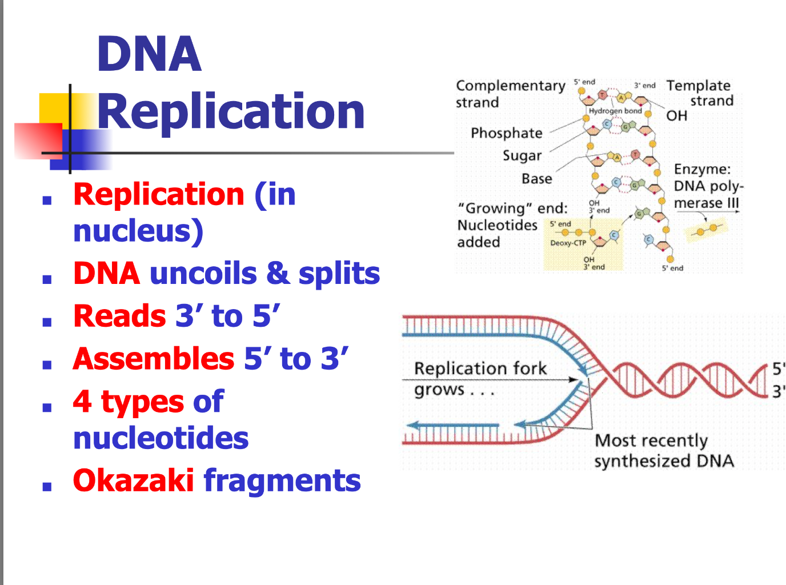

Slide 40
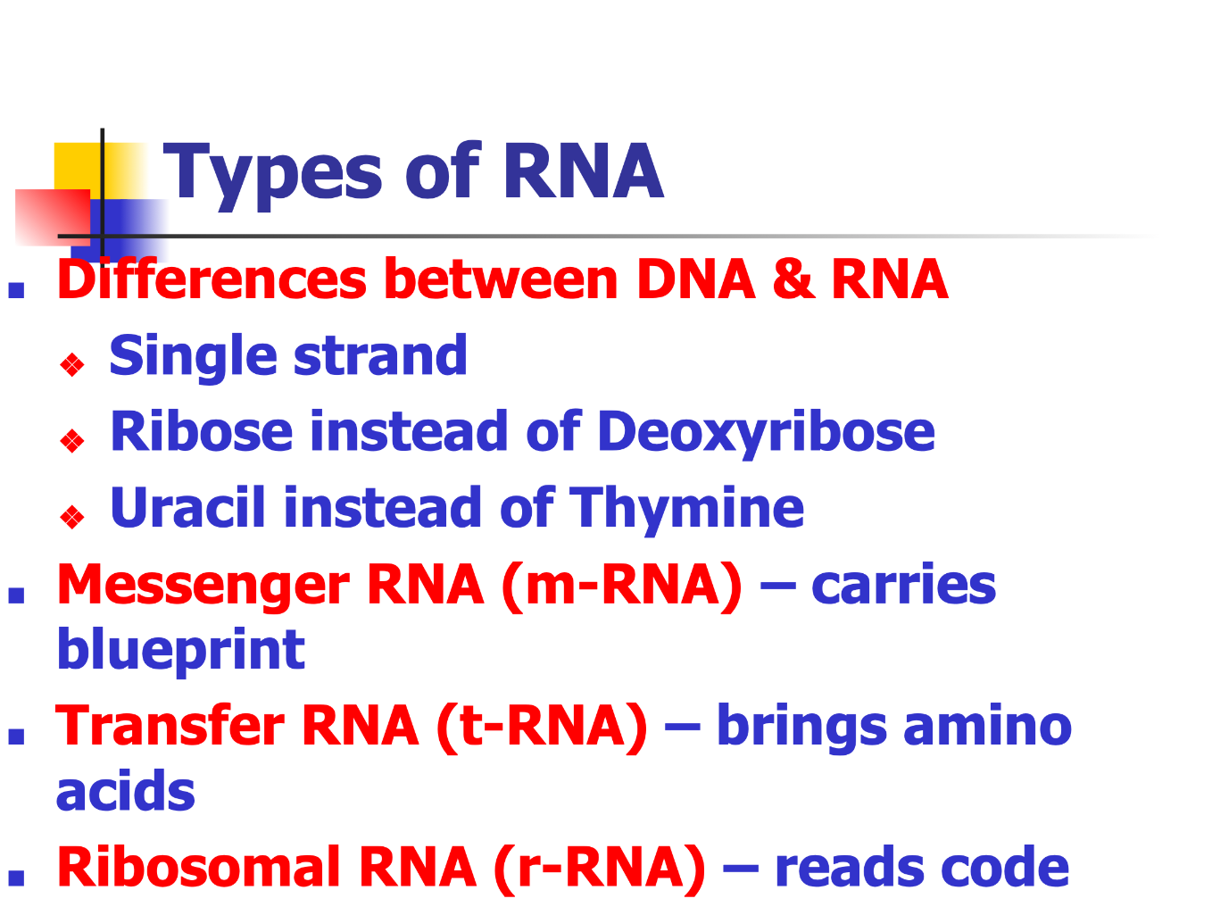

Slide 41
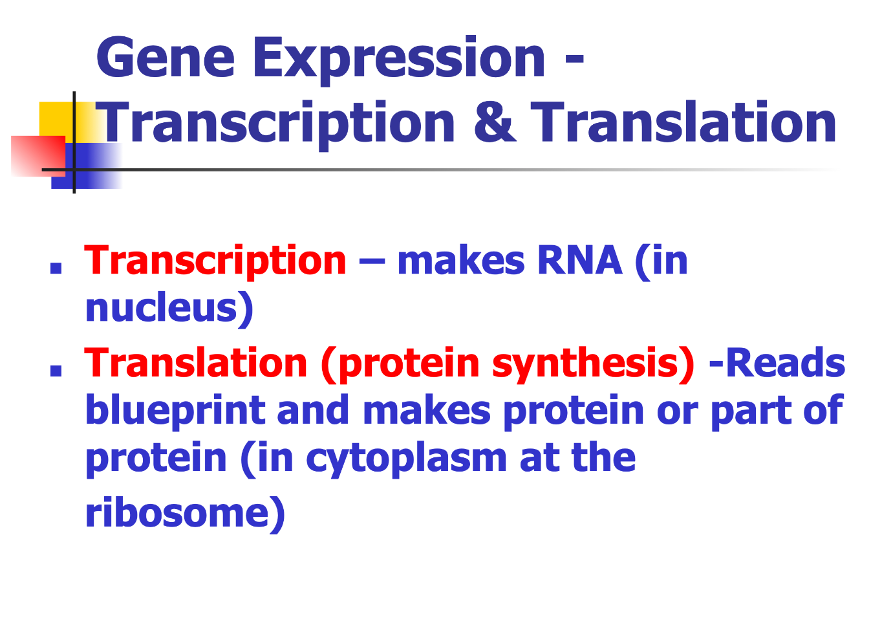

Slide 42
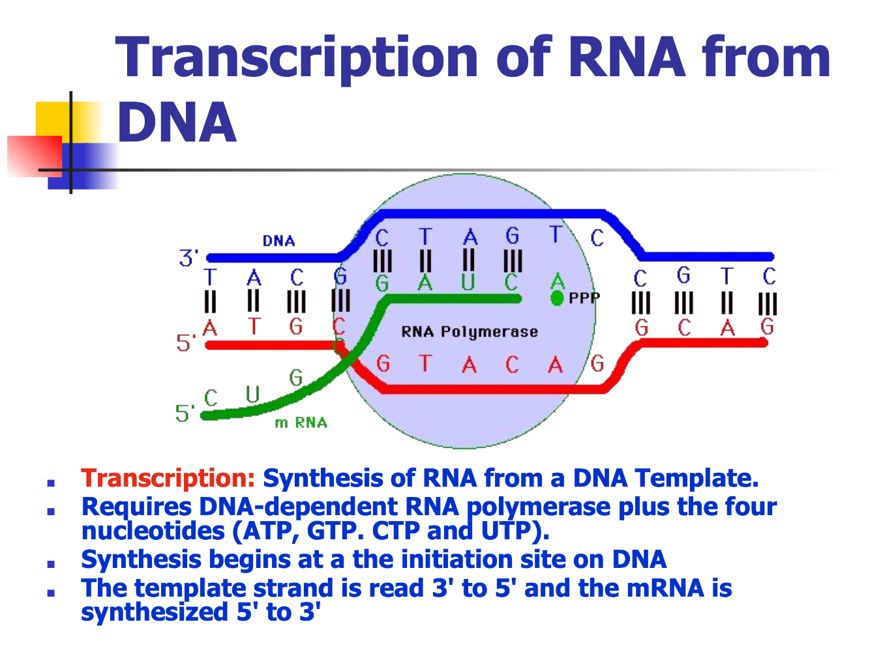

Slide 43
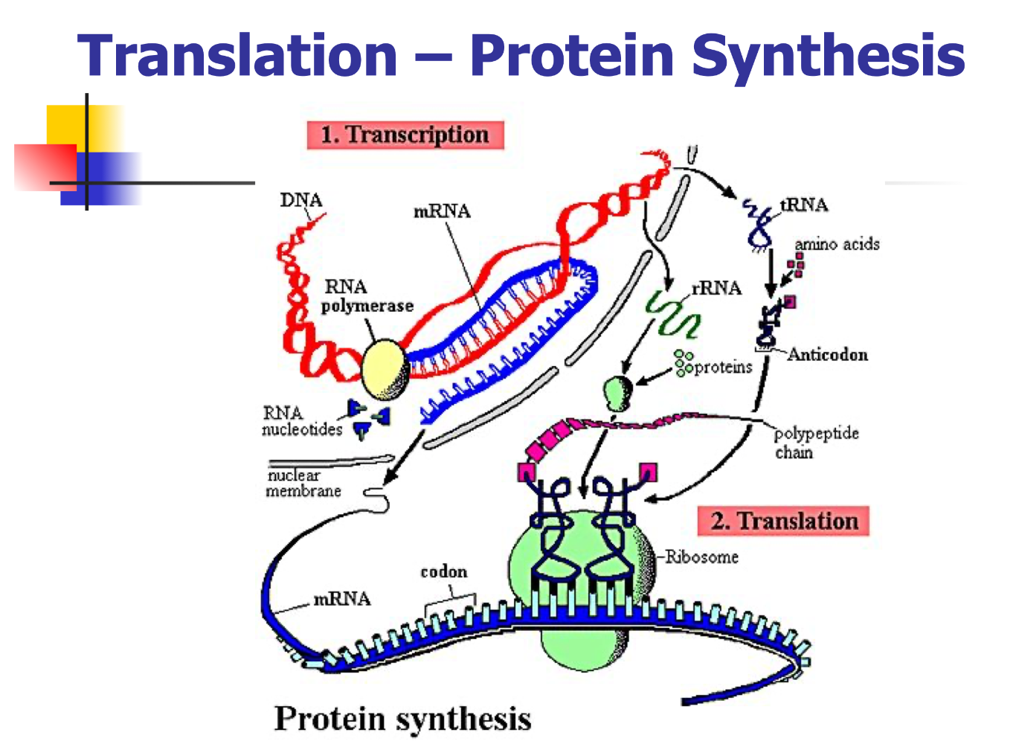

Slide 44
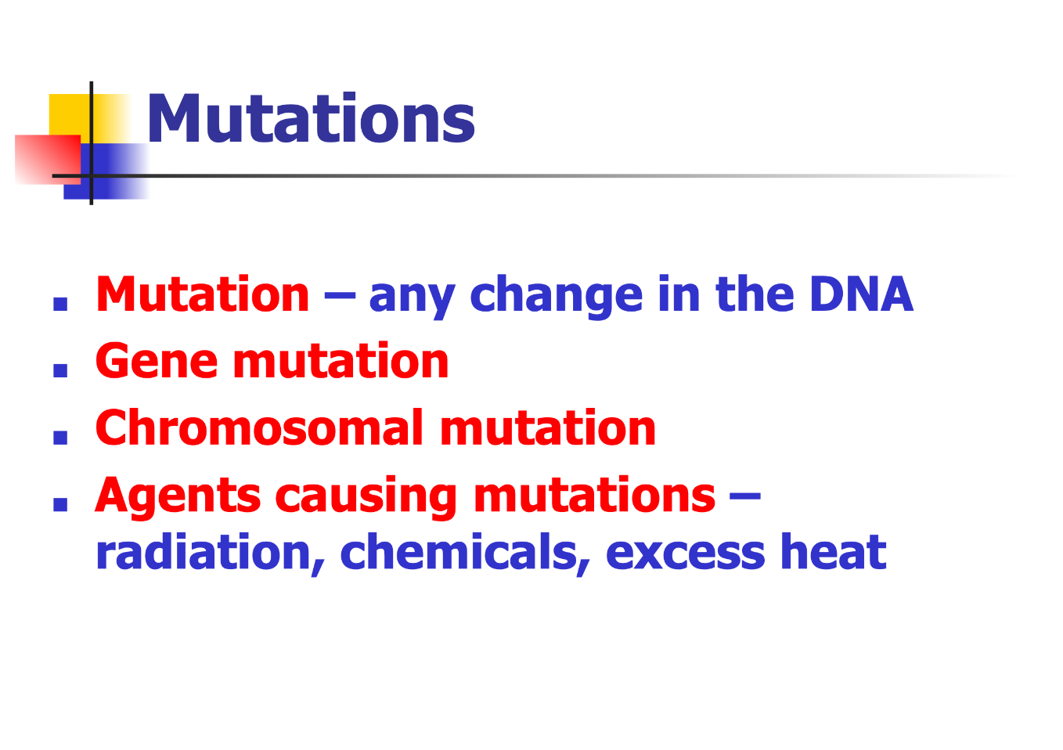

Slide 45
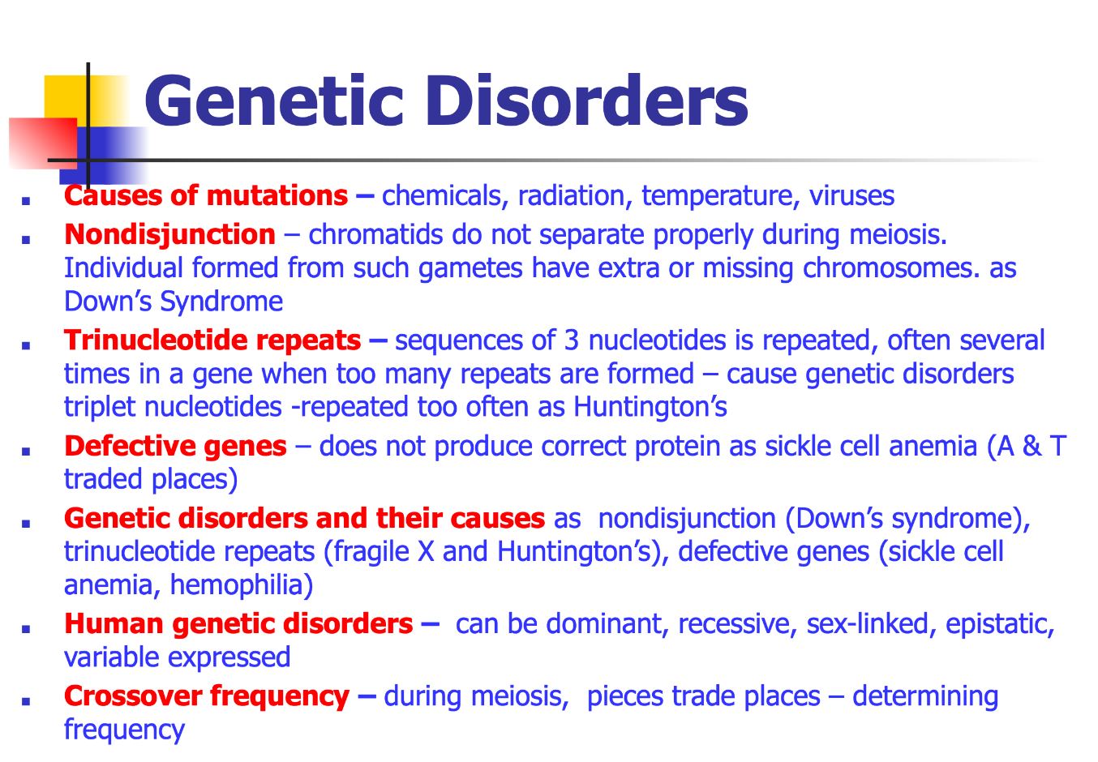

Slide 46
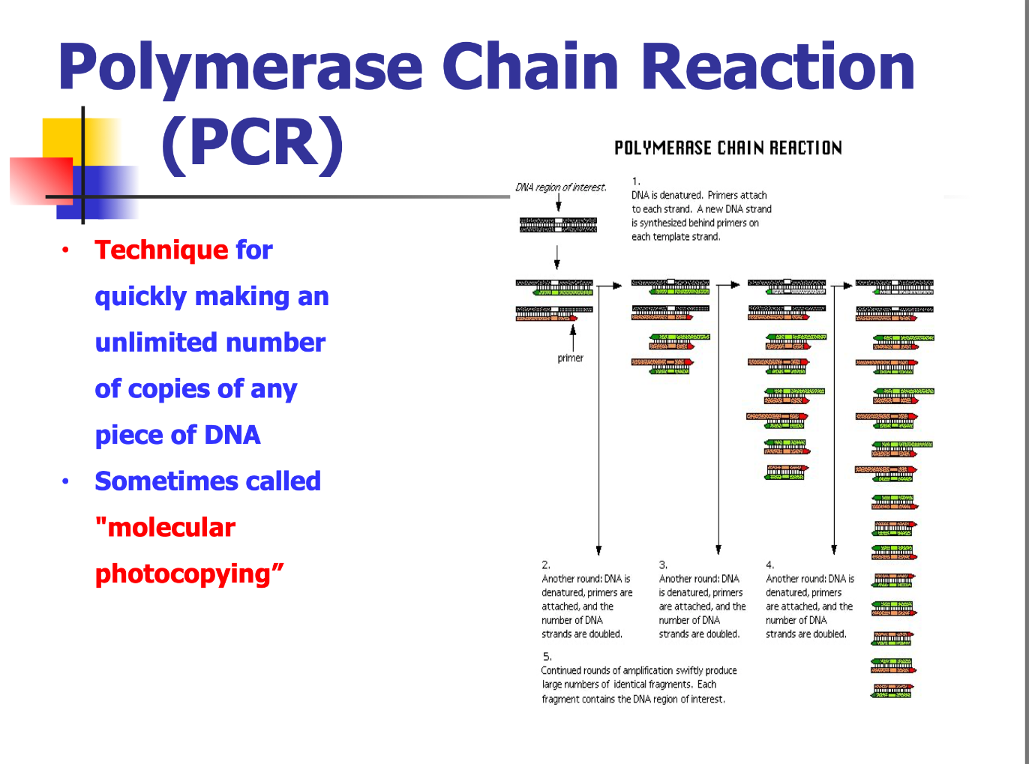

Slide 47
Hope that helps!

